Slide 1
Cancer Care Delivery Reform:
Role of Early Palliative Care and Communication about EOL Care
Jennifer Temel, MD
Massachusetts General Hospital
March 7 2013

Slide 2
Making the Case for Cancer Care Delivery Reform in Oncology
Patients experience a high physical symptom burden and both patients and families experience psychological suffering
Patients and their families often have a limited understanding of their illness and an inaccurate view of their prognosis
These patients face incredibly difficult decisions about their cancer treatment and end-of-life care
The care they receive is often intensive or “aggressive” and costly

Slide 3
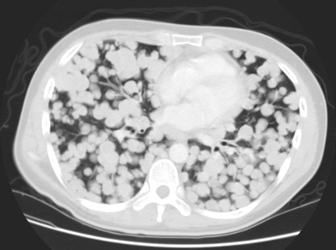
Cancer therapy can improve symptoms… but it is not sufficient

Slide 4

Quality of Life in Advanced Cancer
Cancer-related Symptoms
Pain Dyspnea Fatigue
Chemo-related Symptoms
Fatigue Nausea Neuropathy
Psychosocial, emotional, spiritual, financial, family caregiver issues not impacted by therapy

Slide 5
Illness and Prognostic Understanding and its Impact on Decision-Making

Slide 6
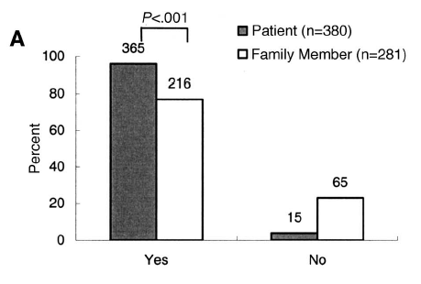
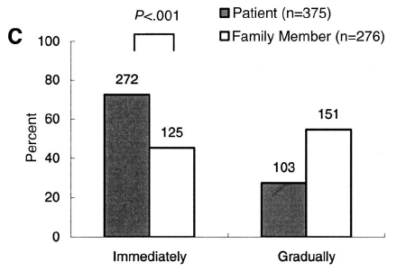
What do patients with advanced cancer want to know about their illness?
Do you want to be informed the truth?
When is the appropriate time to be informed the truth?
Yun, JCO 22 (2) 2004

Slide 7
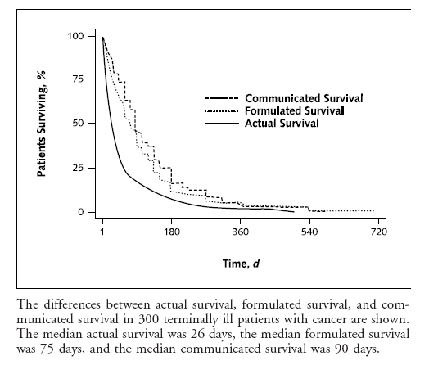
What do clinicians tell patients about their prognosis?
Median formulated prognosis 75 days
Median communicated prognosis 90 days
Median actual survival 26 days
Lamont, Annals of Int Med 134 (12) 2001

Slide 8
What is the problem with patients having an overly optimistic prognosis?
Patients with an overly optimistic perception of their prognosis are more likely to choose aggressive therapy and less likely to receive hospice care.
  Patients who overestimated their chance of survival were:
    2.5 times more likely to receive life-extending therapy.
    significantly less likely to have discussed hospice care.
Weeks, et. al., JAMA, 279 (21) 1998
Huskamp Archives 169 (10)2009

Slide 9
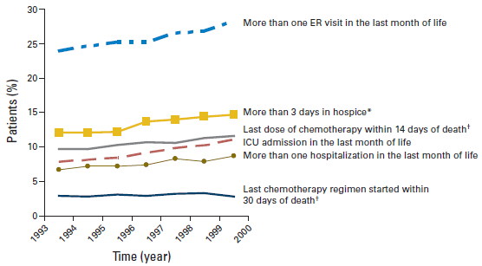
Intensive or “Aggressive” Care Near the EOL
Earle JCO 26 (23) 2008

Slide 10
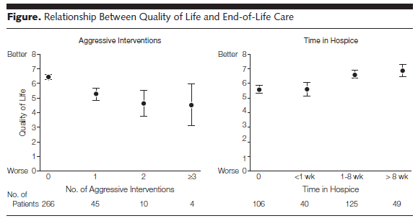
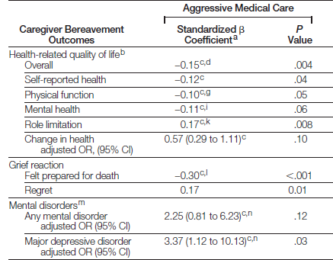
Intensive Medical Care Near the EOL is…..Bad for Patients and their Family Caregivers
Patient QOL
Caregiver Outcomes
Wright JAMA 300 (14) 2008

Slide 11
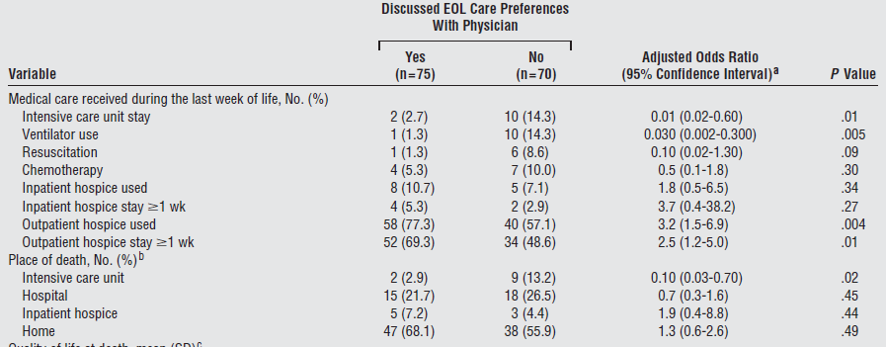
Intensive Medical Care Near the EOL is…Costly
Zhang Archives 169 (5) 2009

Slide 12
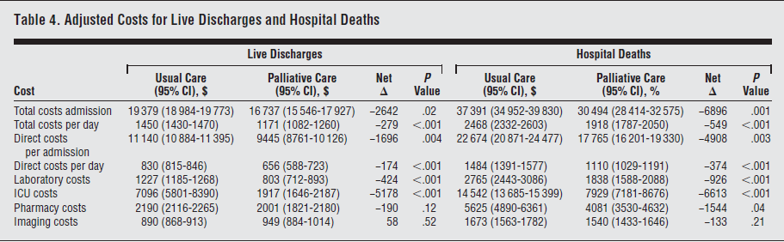
Hospital-Based Palliative Care Consults Decrease Health Care Costs
Morrison, Archives 168 (16) 2008

Slide 13
How Should we Design Interventions to Improve The Delivery of Cancer Care?
Focus on patients in the ambulatory care setting
Allow patients to continue to receive cancer care and therapy
Provide relief from the physical and psychological symptoms
Enhance communication between patients and clinicians to improve decision-making
Provide more appropriate care at the EOL

Slide 14
Potential Targets for Interventions to Improve The Delivery of Cancer Care
Patient
Family
Clinician

Slide 15
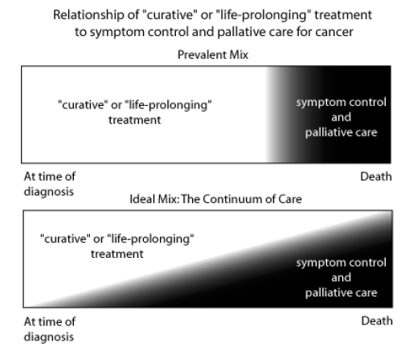
Integrating Palliative and Oncology Care

Slide 16
Early, Integrated Palliative Care in Patients with Metastatic Lung Cancer
Palliative Care Model
Palliative care provided by physicians and nurse practitioners
Visits occurred in the Cancer Center (medical oncology, radiation oncology or chemotherapy visits).
Oncology and palliative care visits were done in tandem or simultaneously.
Visits were not scripted or prescribed.
If patients were admitted to the hospital, they were followed by the palliative care team
Early palliative care integrated with standard oncology care
150 patients with newly diagnosed metastatic NSCLC
Standard oncology care
Notes:
16
Patients who have an understanding of their life expectancy are participate in ACP are more likely to accept hospice at the EOL. Thus providing more comprehensive support for patients throughout the course of their disease may not only benefit their current health status but also allow for a more timely transition to hospice care. Integrated oncology and palliative care can bridge the gap between cancer-directed and comfort-oriented therapies in advanced cancer patients.

Slide 17
Early Palliative Care Model
Resource Utilization
Chemotherapy administration
Hospice
Location of death
QOL
Mood
Illness understanding
Patient
Family
Clinician
QOL
Mood

Slide 18
Baseline Perceptions of Prognosis and Goals of Treatment
Goal of therapy is to get rid of all cancer
My cancer is curable
Temel JCO 29 (17) 2011

Slide 19
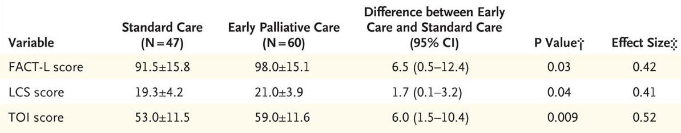
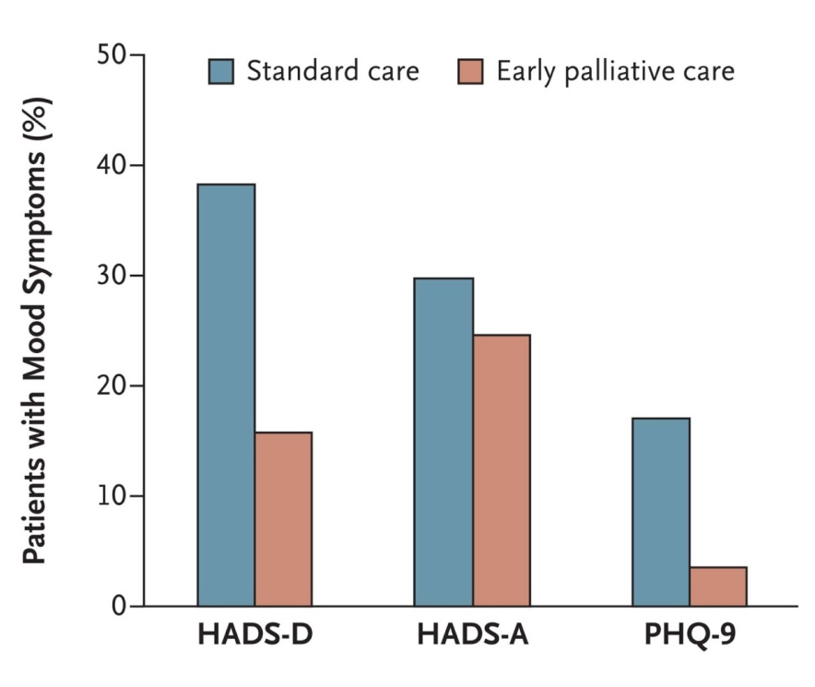
Impact of Early Palliative Care on Patient Reported Measures
38 v 16%. p=0.01
17 v 4%. p=0.04
Temel NEJM 363 (8) 2010

Slide 20
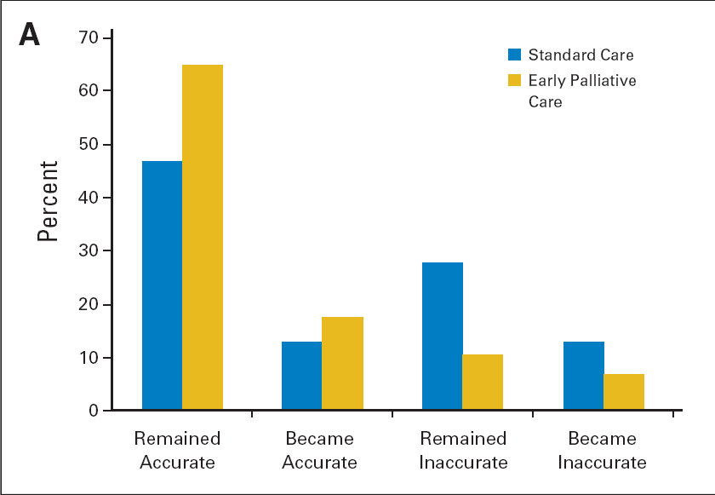
Changes Over Time in Perceptions of Prognostic Understanding
Report Cancer as Incurable
Report Cancer as Curable
Palliative care v standard care 82.5% v 59.6%, p=0.02
Temel JCO 29 (17) 2011

Slide 21
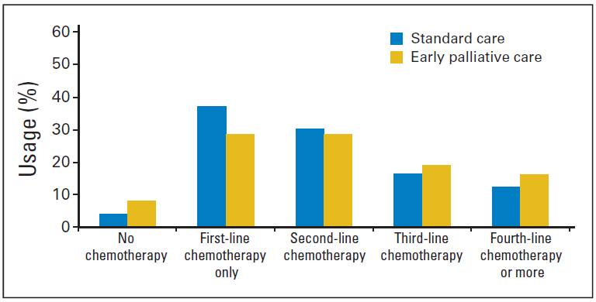
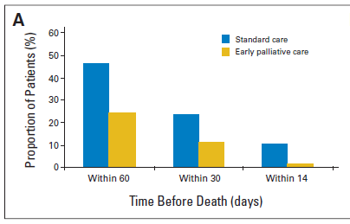
Chemotherapy Utilization
Chemotherapy utilization over the course of illness
Chemotherapy utilization near the EOL
Greer JCO 30 (4) 2012

Slide 22
Resource Utilization
Variable | Standard Care N (%) or Median | Early Palliative Care N (%) or Median | P-Value
Hospice Care Received hospice care Received hospice care > 7 days before death Median days on hospice | 44/67 (66) 21/63 (33) 9.5 (1-268) | 44/62 (71) 36/60 (60) 24 (2-116) | 0.57 0.004 0.02
Location of Death Home Inpatient hospice Hospital/nursing home/rehabilitation facility | 36/66 (55) 13/66 (20) 17/66 (26) | 40/61 (66) 9/61 (15) 12/61 (20) | 0.28 0.49 0.53
Greer JCO 30 (4) 2012

Slide 23
Impact of Early Palliative Care on Health Care Costs at the EOL
Cost Difference=$2,282 (Median=$2,432)
PRESENTED BY: Greer JA et al.
Greer ASCO 2012

Slide 24
Costs at End of Life by Category
 | Standard Care N=65 | Early Palliative Care N=60 | Cost Difference
Inpatient Visits % of patients Mean cost (SD) | 46% $12,665 (20,580) | 38% $9,555 (17,275) | $3,110
Outpatient Visits % of patients Mean cost (SD) | 80% $1,415 (1,649) | 77% $1,683 (2,027) | $268
Chemotherapy % of patients Mean cost (SD) | 42% $1,654 (1,654) | 28% $1,014 (1,913) | $640
Hospice Services % of patients Mean cost (SD) | 65% $1,808 (2,117) | 70% $2,933 (4,011) | $1,125
Greer ASCO 2012

Slide 25

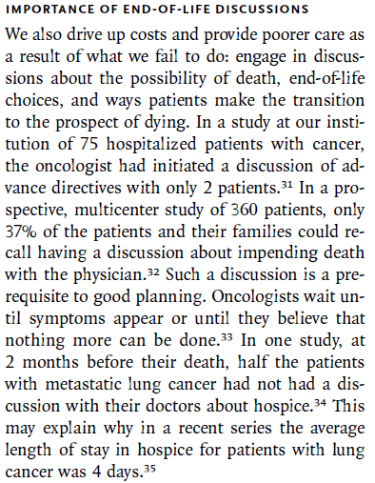
Targeting Clinicians
Patient
Family
Clinician

Slide 26


Can we alter oncologists behavior to initiate EOL discussions?
Intervention based upon the theory of academic detailing to improve clinician decision-making and practice behaviors
First email sent morning of first outpatient appointment after signing consent
Subsequent emails sent morning of first outpatient appointment following start of new line of therapy
Emails sent to attending MD and all others scheduled to see patient (fellow or nurse practitioner)
Email most acceptable
Sent early in the course of disease
Succinct and clearly identify patient
Contain minimal clinical information
Sent close to the time of visit
Temel JCO 31 (6) 2013

Slide 27
Rate of Code Status Documentation
Code Status Documentation | Email Prompt Cohort N (%) | Historical Cohort N (%) | p-value | OR (95% CI)
Ambulatory Care Setting Full Code DNR/DNI Hospital Setting | 33/98 (33.7) 4/98 (4.1) 29/98 (29.6) 2/100 (2.0) | 12/83 (14.5) 2/83 (2.4) 10/83 (12.0) 13/100(13.0) | .003 .69 .006 .005 | 3.00 (1.43, 6.31) 1.72 (0.31, 9.66) 3.07 (1.39, 6.76) 0.14(0.03, 0.62)
Temel JCO 31 (6) 2013

Slide 28

Targeting Patients
Patient
Family
Clinician
Even when discussions regarding resuscitation preferences are initiated, they are often ineffective due to poor communication and patients’ lack of sufficient medical knowledge to engage in discussions.
3 minute video of CPR:
Developed and edited with an expert panel of oncologists, intensivists, decision making experts, patients and families,
150 patients with advanced cancer and a prognosis < 1 year
Video description of CPR
Verbal description of CPR
Volandes, JCO 31 (3) 2013

Slide 29
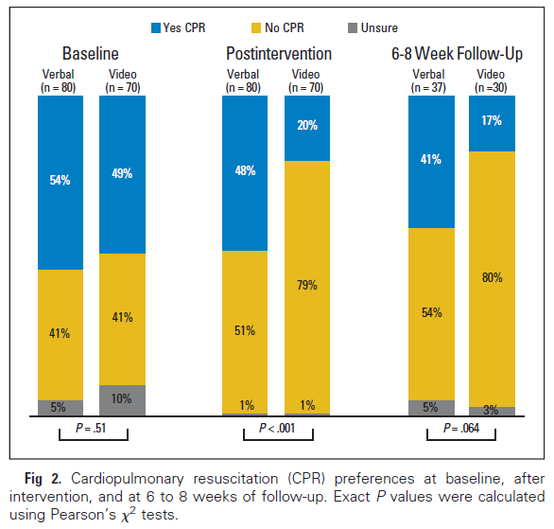
Patient Preference for CPR
Volandes, JCO 31 (3) 2013

Slide 30
Knowledge Regarding CPR
Baseline
4 Questions:
Definition of CPR
Chance of survival after CPR
Complications from CPR
Chance of leaving hospital after CPR
P < 0.001
Post Intervention
3.3
2.6
Δ 1.3
Δ 0.5
2.1
2.0
Verbal
Video
N=80
N=70
Volandes, ASCO 2012

Slide 31
Summary
Novel models of care targeting health care delivery systems, clinicians and patients can alter patterns of care to:
  Decrease resource utilization
  Increase rates of EOL care discussions and documentation
  Enhance patients perception/ knowledge regarding
Further research to investigate the impact of these interventions on the cost of cancer care is warranted.
Thank you to the Thoracic Oncology Team and Patients and the Supportive Care Research Group at MGH
Support provided by:
  Conquer Cancer Foundation
  American Cancer Society
  National Institutes of Nursing Research
  Golf Fights Cancer
  The Joanne Hill Monahan Fund

